Slide 1
Analysis of Spotify Data with Python
SoftServe Project. LV - 518

Slide 2
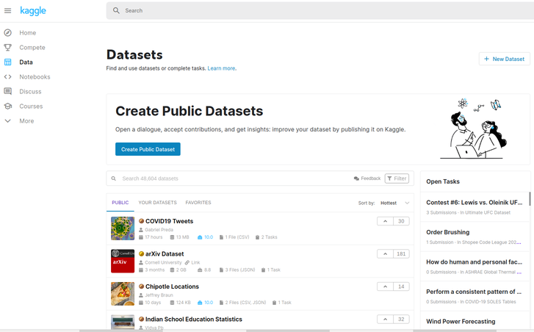
Step 1: Find your Database
Options:
Spotify Request
Available Databases online
Used: https://www.kaggle.com/

Slide 3
Step 2: Analyze your Data
Dataset: Data.csv
Columns: print(your_data.columns)
Interesting features of Spotify Data:
acousticness | danceability | energy
instrumentalness | liveness | loudness
popularity | speechiness | tempo
valence
Task of the project: Analyze data according to the spotify song characteristics

Slide 4

Imported Libraries
Pandas - high-level data manipulation tool, which allows to store and manipulate tabular data in rows and columns. Key data structure: DataFrame.
Matplotlib.pyplot - MATLAB-like way of plotting data, e.g., creates a figure, plots some lines in a plotting area, decorates the plot with labels, etc.
Seaborn - a library for statistical graphics in Python. Examples of usage: convenient views onto the overall structure of complex datasets, concise control over matplotlib figure styling with several built-in themes
Often used: NumPy (Numerical Python) - library used for working with arrays, which is also used for working in domain of linear algebra, fourier transform, and matrices.

Slide 5
Step 3: Import and read your Data

Slide 6

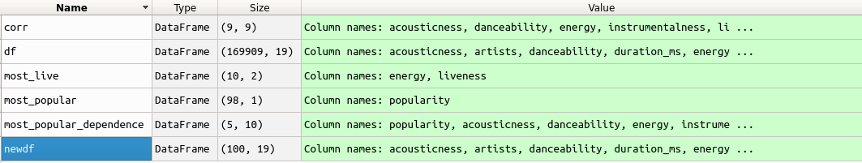
Step 4: Create new DataFrame

Slide 7
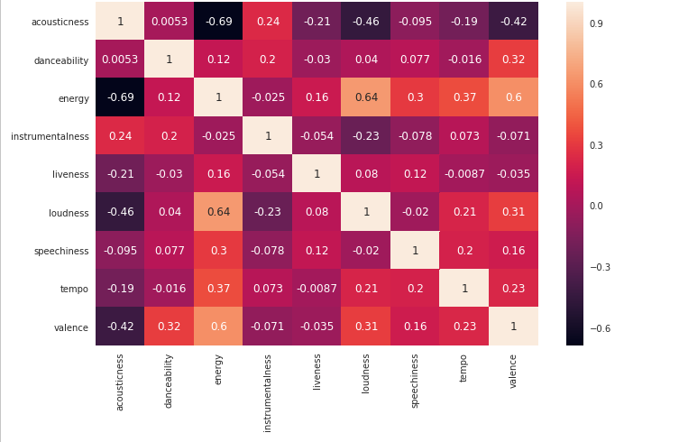

Step 5: Analyze correlation between attributes

Slide 8
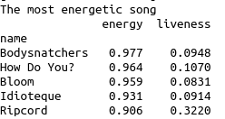

Step 6: “The most … song”

Slide 9
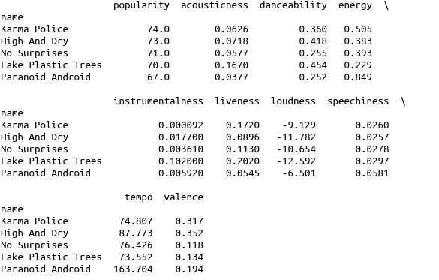
Suggestion for Improvement

Slide 10
Suggestion for Improvement
Karma Police | Energy (2) Dance (3) Acoustic(3) Liveness(2) Valence(2)
High and Dry | Instrument(2) Loud(2) Temp(2) Valence(2) Acoustic(2) Dance(2)
No Surprises | Liveness(3) Loud(3) Speech(3) Temp(3) Energy(3)
To try out later: MAX() 5 for each feature and compare with the popularity list.

